Slide 1
Artificial Intelligence Boosting w/out Code
Automated AI & Deep Learning
William Hill
Lead Data Scientist
william.hill@vion.com
github.com/will-hill

Slide 2
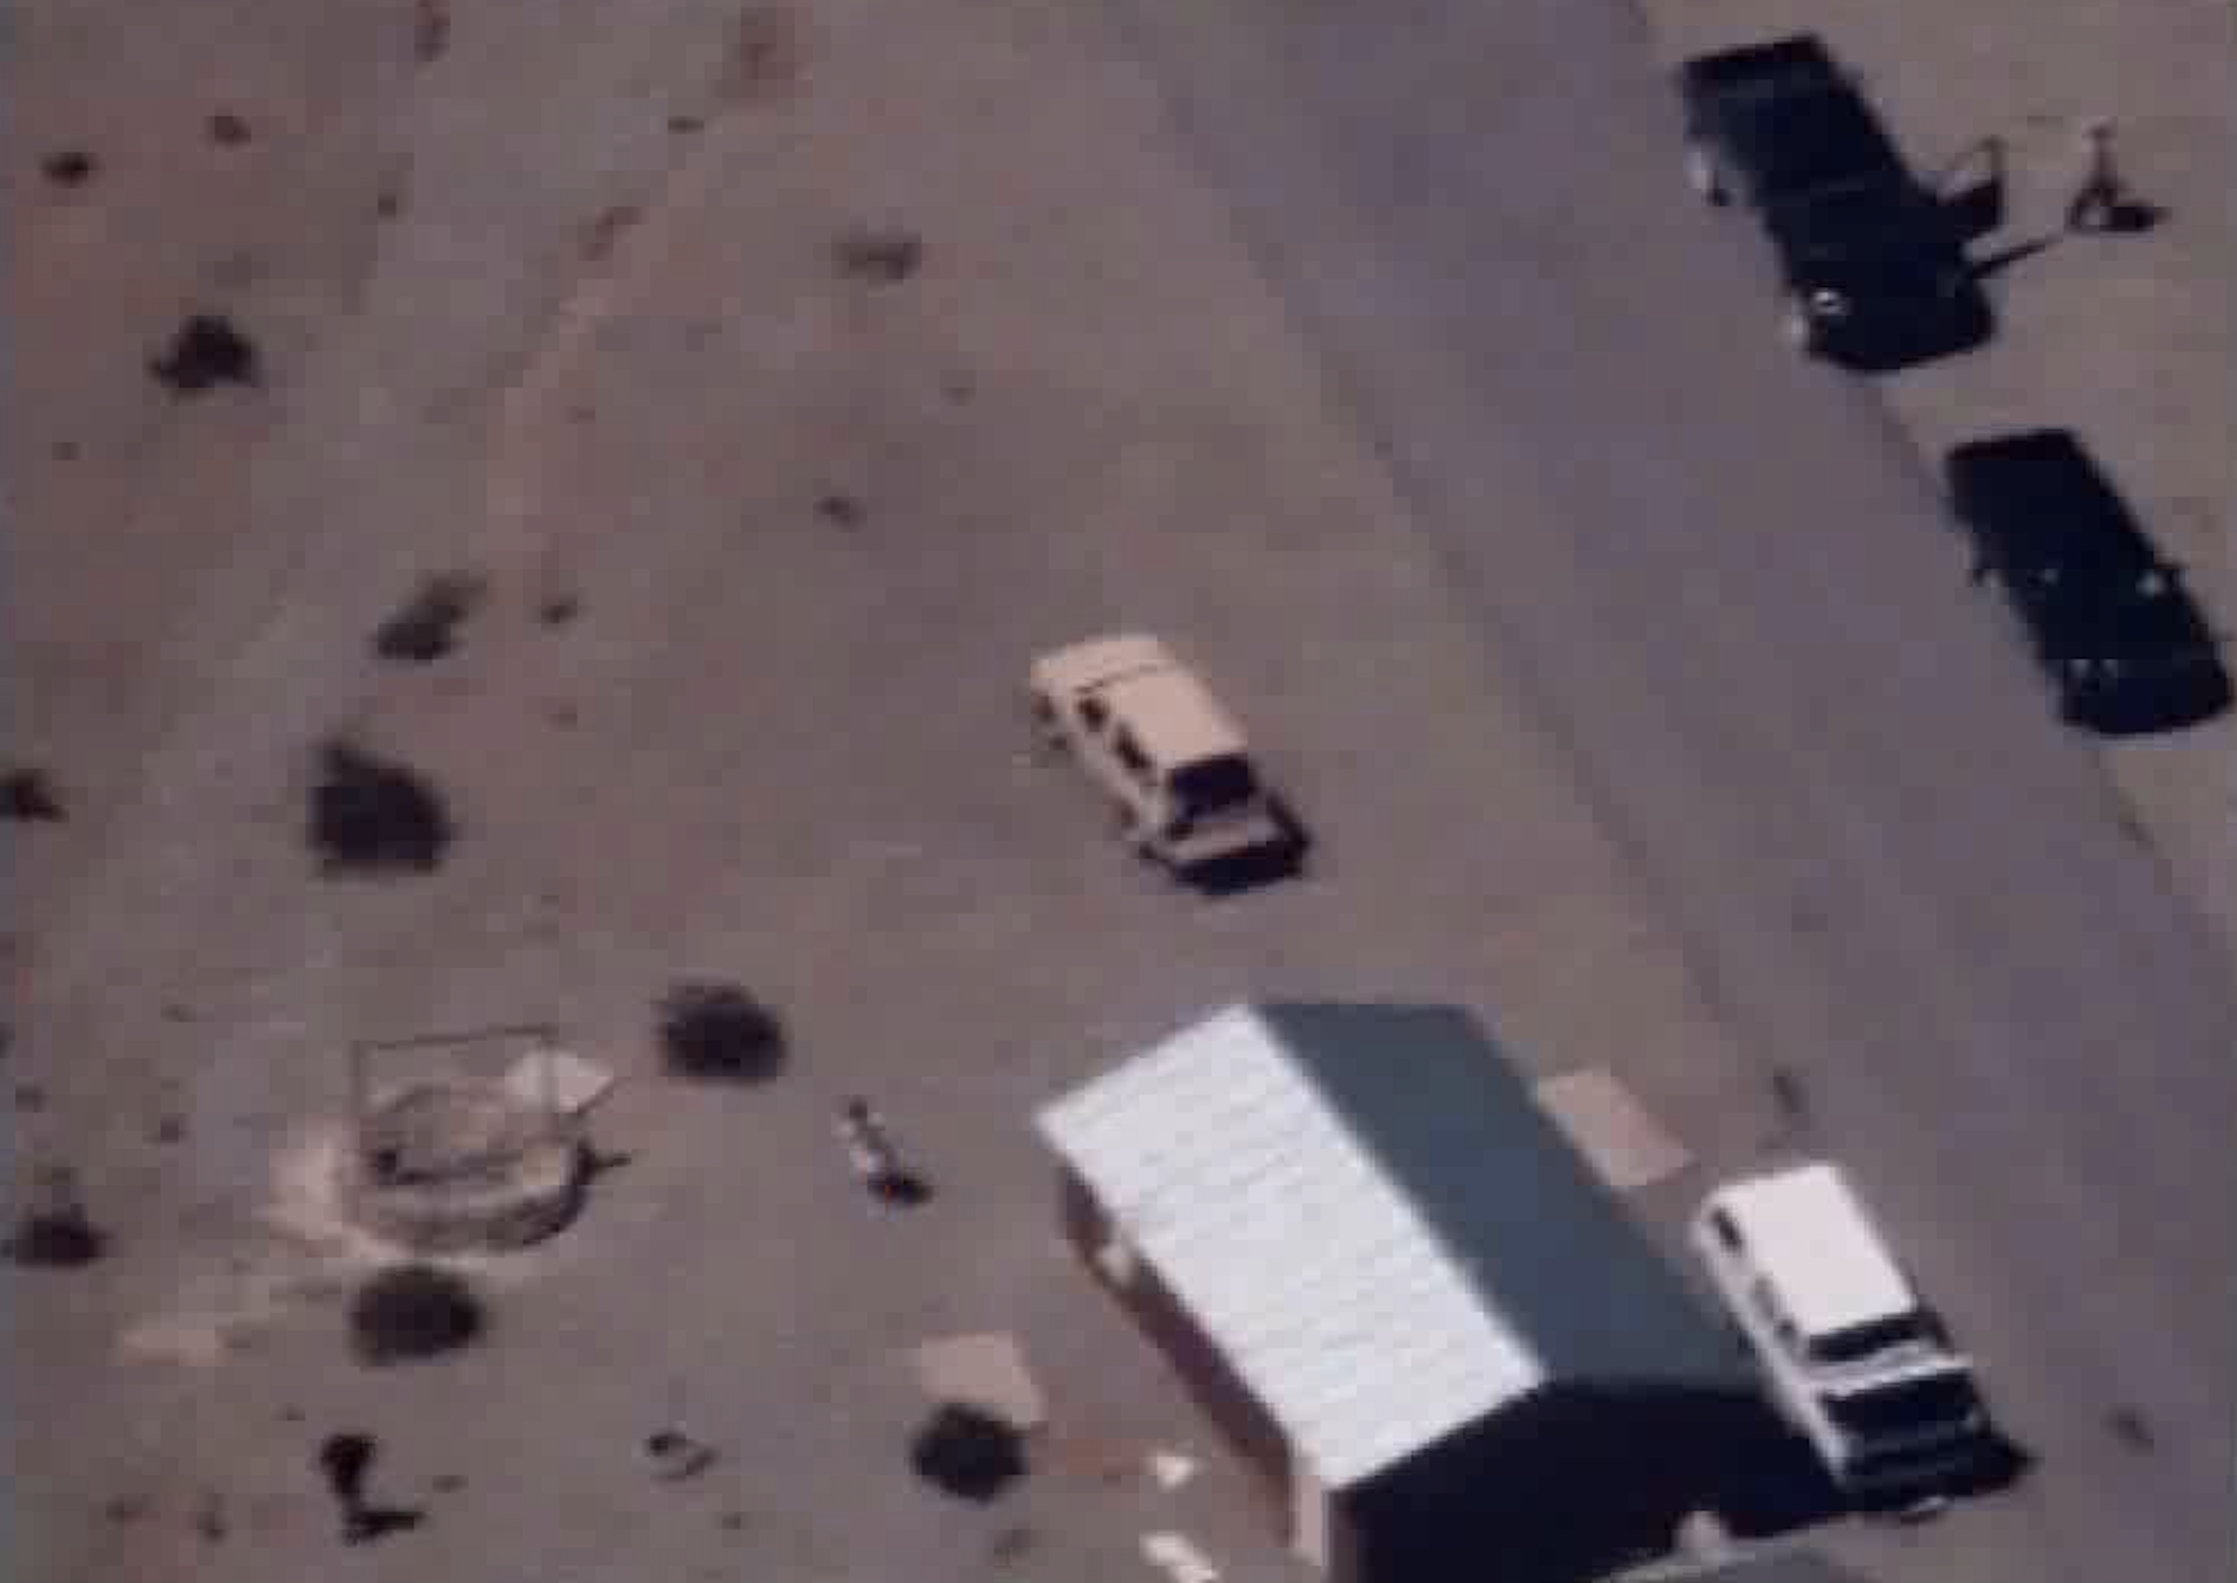
false positive
true negative
How do we fix these?
true positive
false negative

Slide 3
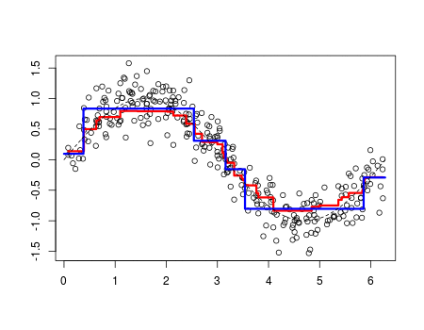
Boosting
“update weights of incorrectly classified images”

Slide 4


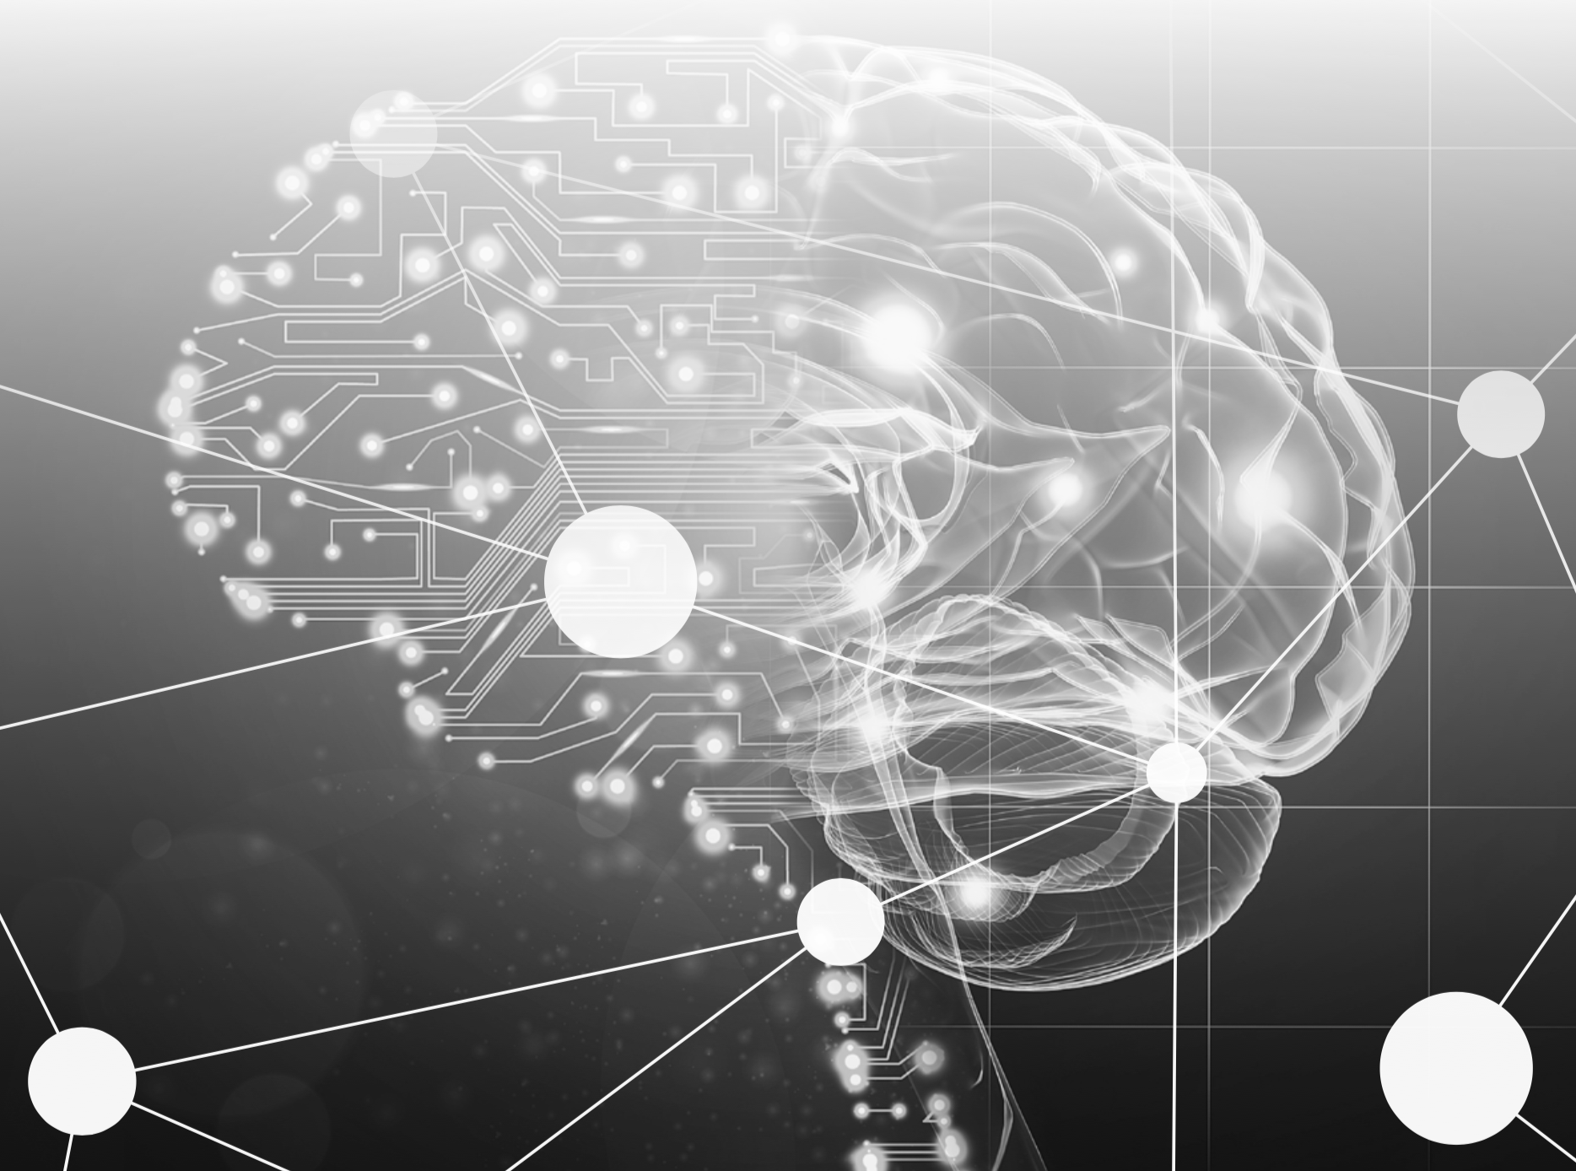





AI Boosting
person
not person

Slide 5
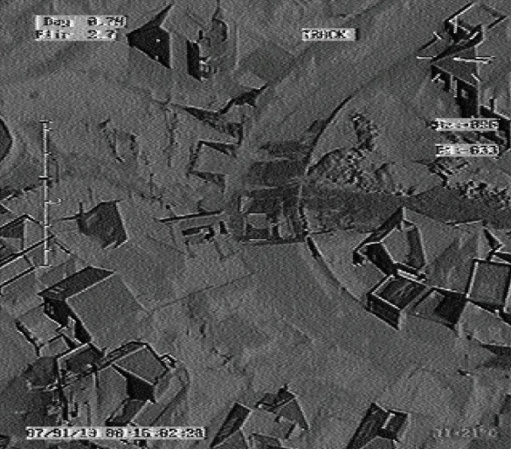
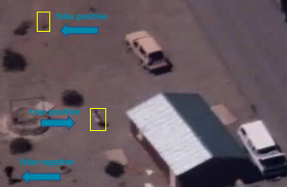
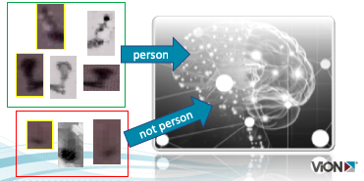
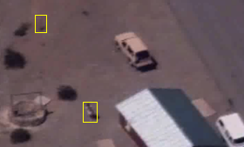
DevOps Cycle
production
validation
algorithm induction
inference

Slide 6
Requirements
Complex GOTs solution, support needed
Boost accuracy & avoid re-certification
Improve performance, induction & inference speed
Easy button - don’t require data scientist

Slide 7
Give me an easy button
Dataiku

Slide 8
Enterprise, Automated, End-to-End, Self-Service
Artificial Intelligence
Deep Learning
Machine Learning
Data Science

Slide 9
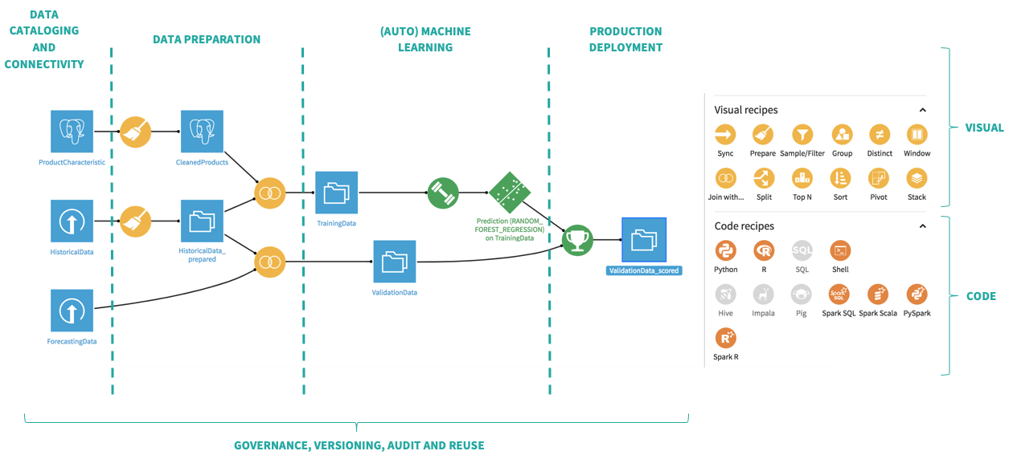

Slide 10
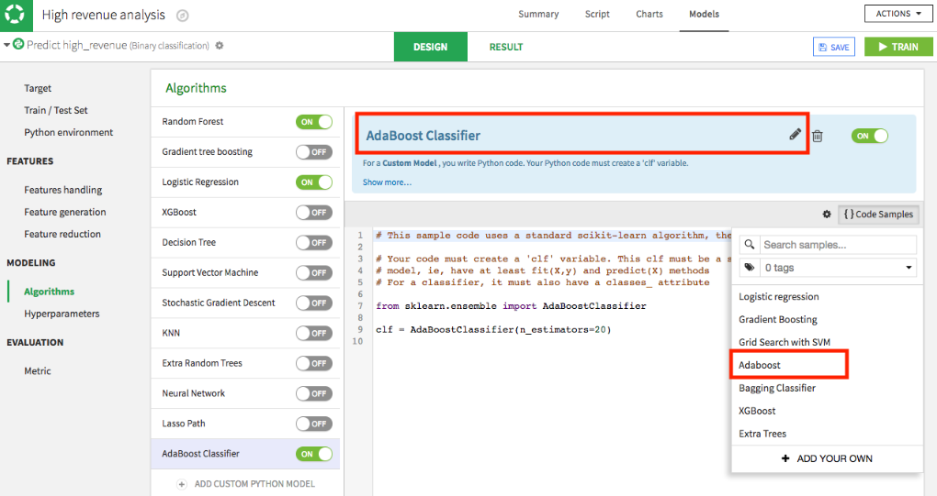
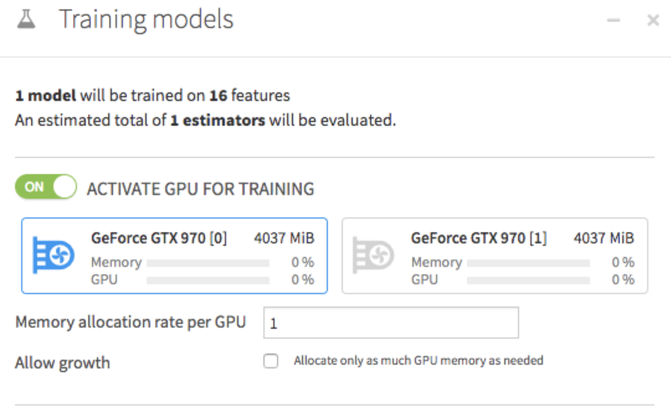
GPU Optimize
GPU optimize

Slide 11
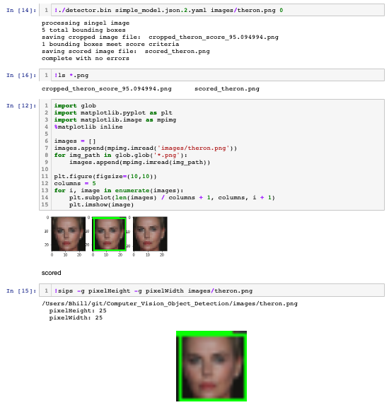
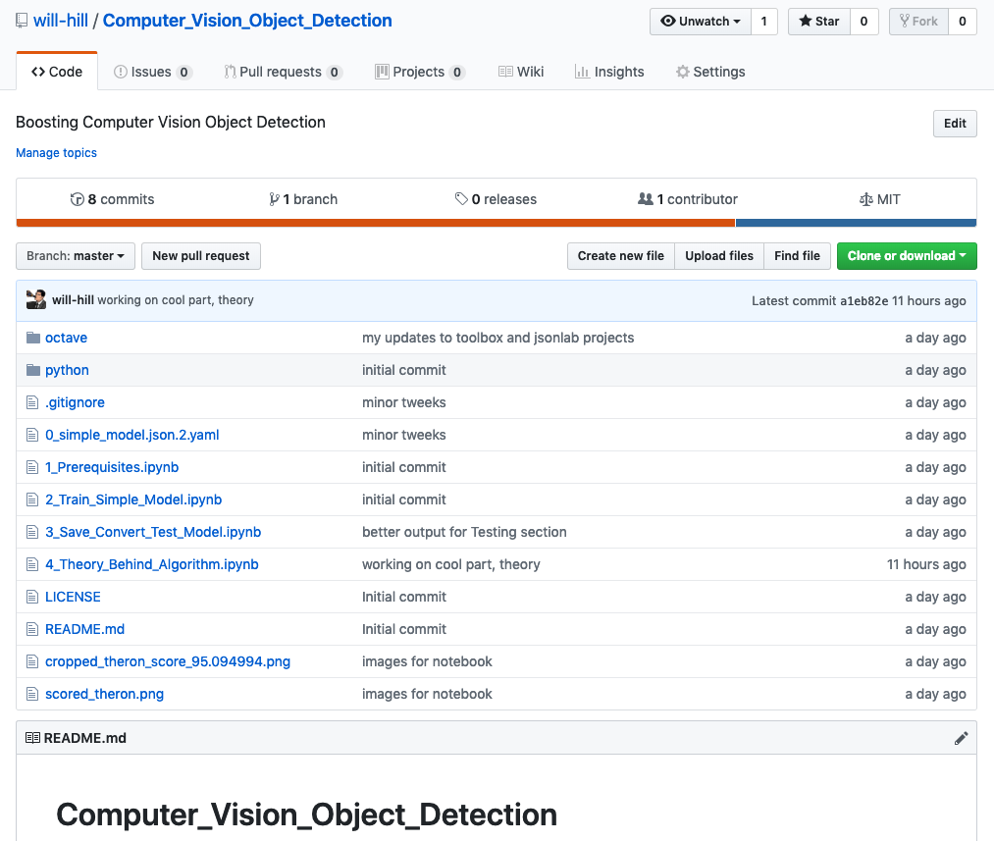
Jupyter Notebook Proof-of-Concept
Notes:
https://www.youtube.com/watch?v=LsK-xG1cLYA

Slide 12
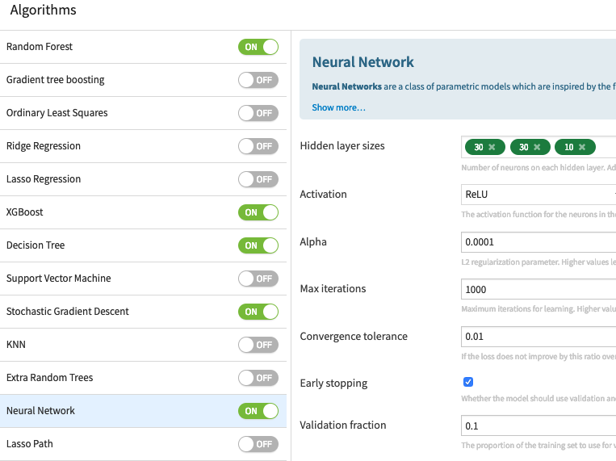
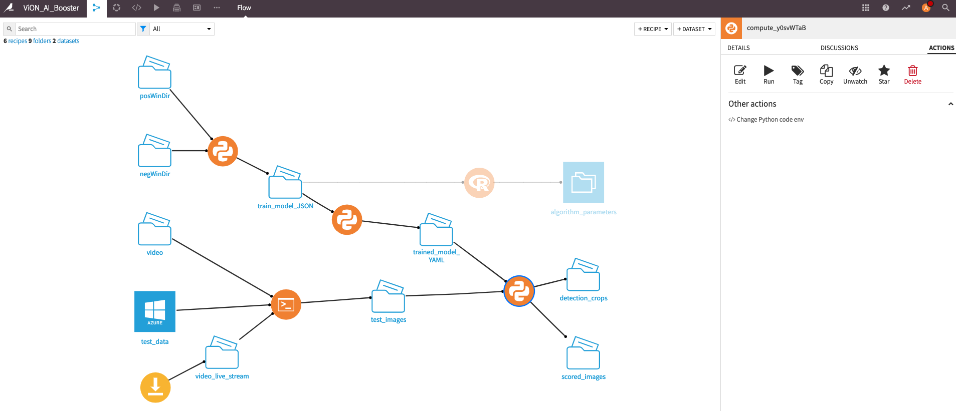
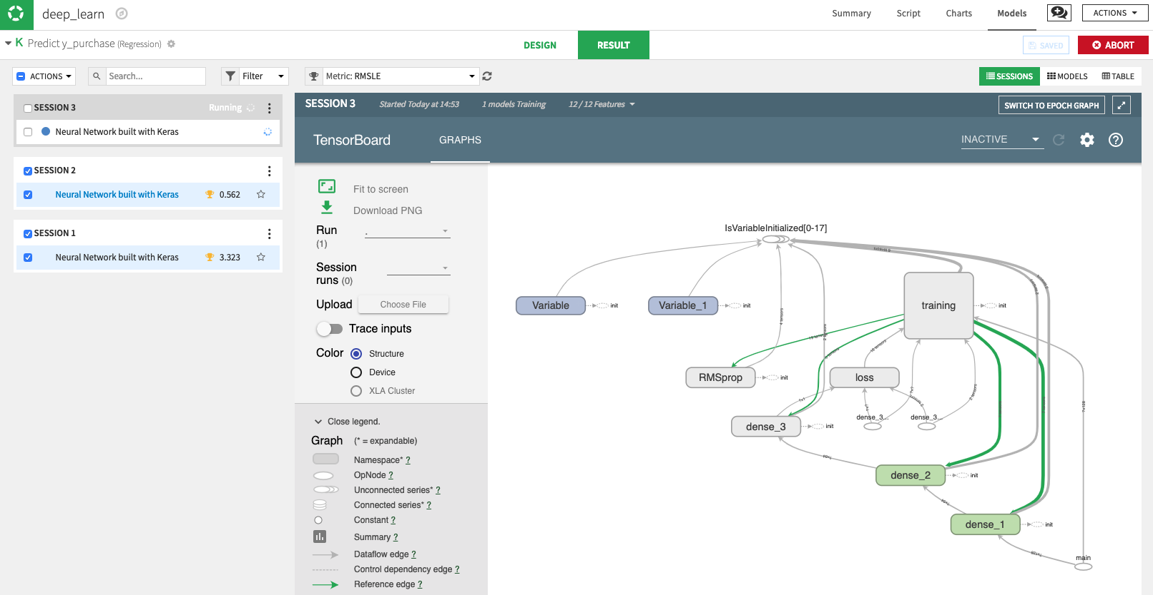
Easy Button Dataiku
easy button
induce / build
Notes:
https://www.youtube.com/watch?v=LsK-xG1cLYA

Slide 13
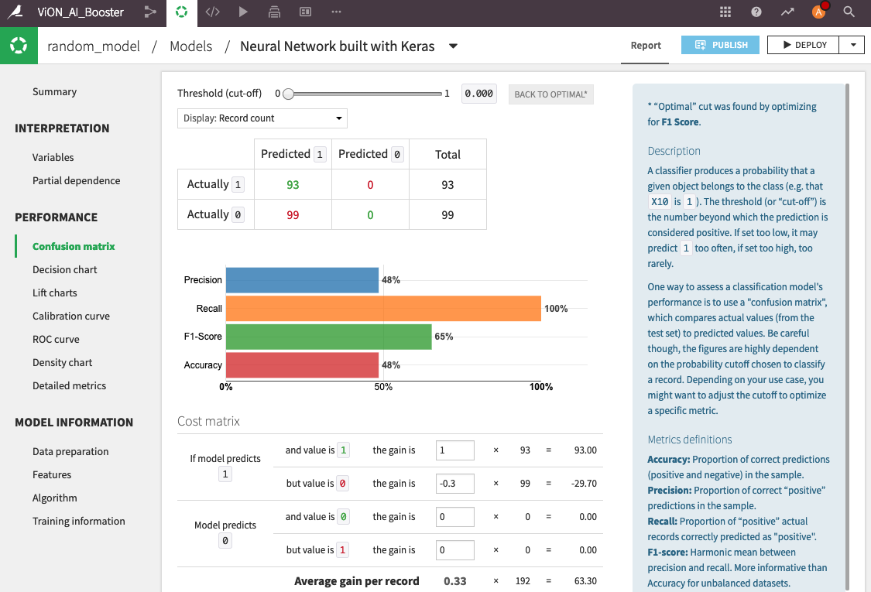
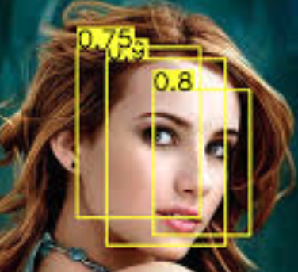
Easy Button Dataiku
deploy
Notes:
https://www.youtube.com/watch?v=LsK-xG1cLYA

Slide 14
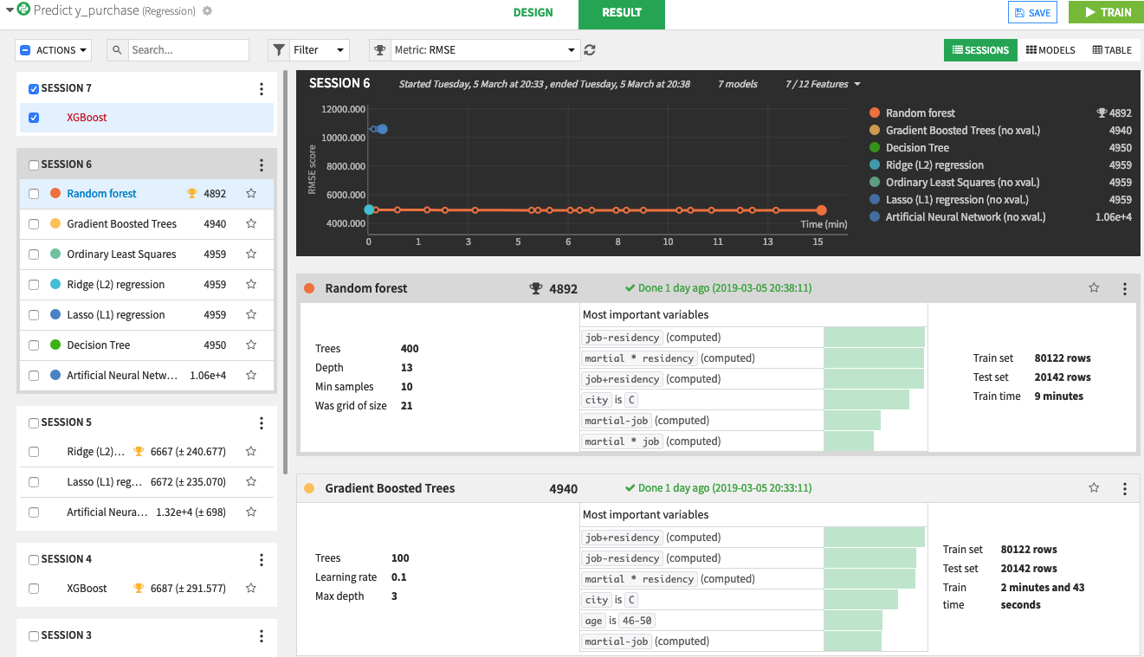
Easy Button Dataiku
test / validate
Notes:
https://www.youtube.com/watch?v=LsK-xG1cLYA

Slide 15
Easy Button Dataiku
production
Notes:
https://www.youtube.com/watch?v=LsK-xG1cLYA

Slide 16
Give me an easy button
DEMONSTRATION

Slide 17
Algorithm Explained
WARNING
In the weeds discussion follows

Slide 18
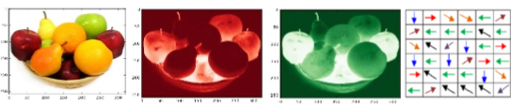

Algorithm Explained
image pyramids
aggregate feature channels
adaboost tree ensemble
non-maximal suppression

Slide 19
What is an image or frame?

Slide 20


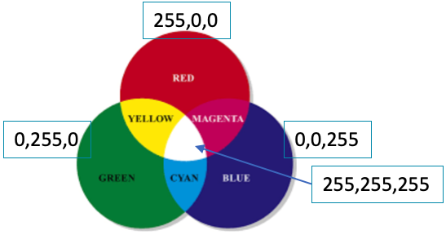

Matrix of Pixels
R:112
G:26
B:20
R:109
G:49
B:39
R:188
G:56
B:49
R:95
G:45
B:27
Matrix of pixels
Each pixel is typically 3 integers
Intensities of red, green, blue (rgb)

Slide 21

Convolution Explained
convolution
image
kernel

Slide 22
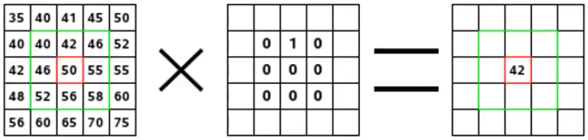
Convolution – kernel applied to pixels
images pixels
kernel
convolution

Slide 23
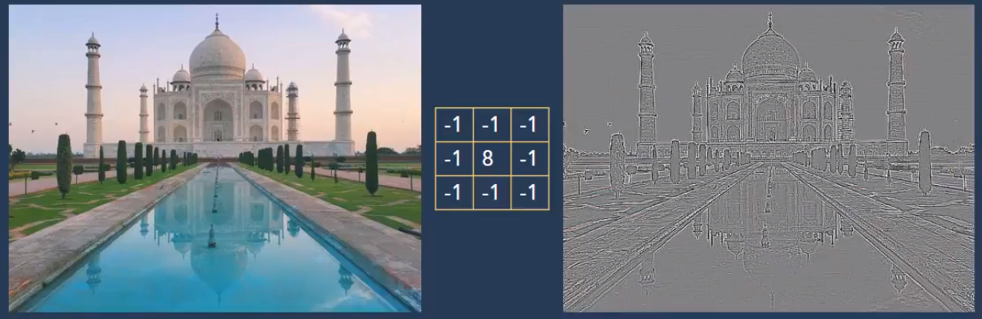
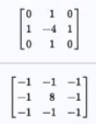
Example Kernel – remove neighbor color
Continuous areas -> grey
Discontinuities -> black & white lines

Slide 24
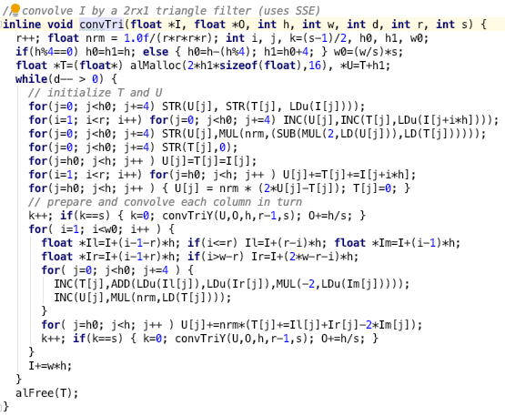
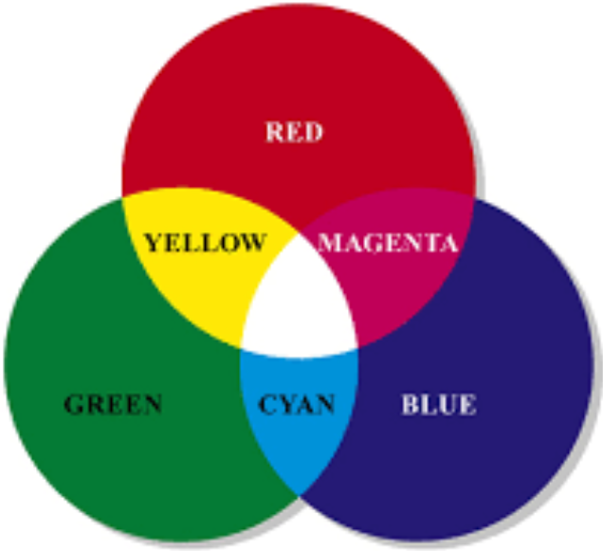
Channels Colors
So many for loops…
ripe for GPU optimization
red
green
blue
255,0,0
0,255,0
0,0,255
255,255,255

Slide 25
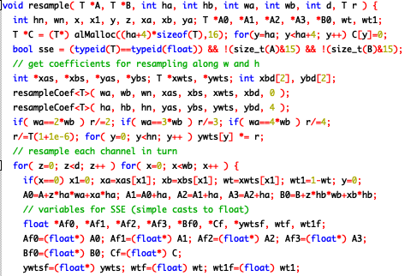
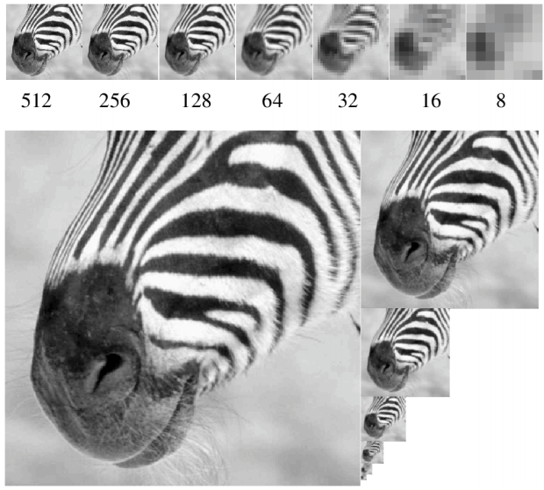
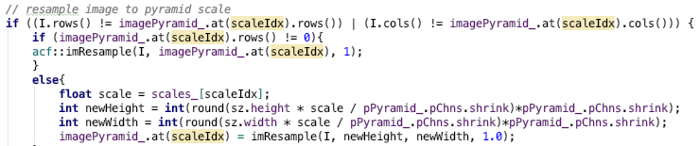
Image Pyramids
looped computations; embarrassingly parallel
order of magnitudes faster with GPU

Slide 26
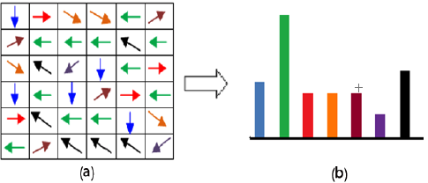
Channels Gradients, Histograms
12 | 34 | 143 | 201 | 255
12 | 34 | 143 | 201 | 255
12 | 34 | 143 | 201 | 255
12 | 34 | 143 | 201 | 255
12 | 34 | 143 | 201 | 255
Gradient Direction/Orientation
As Histogram
Gradient Magnitude

Slide 27
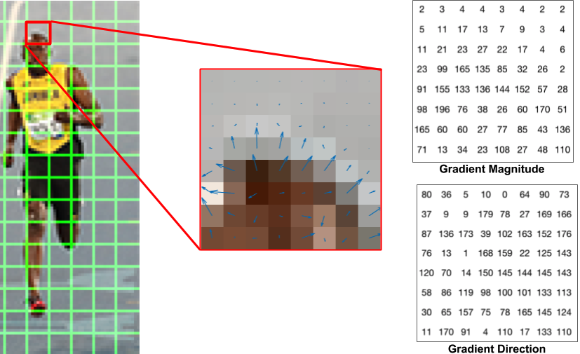
Another Gradient Explanation

Slide 28
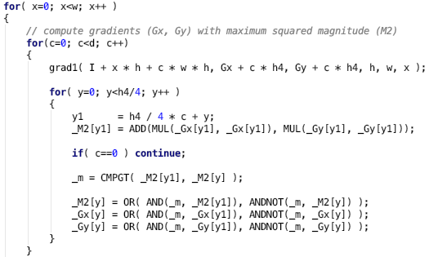
Gradient Calculations
nested for loops;
perfect for GPUs

Slide 29
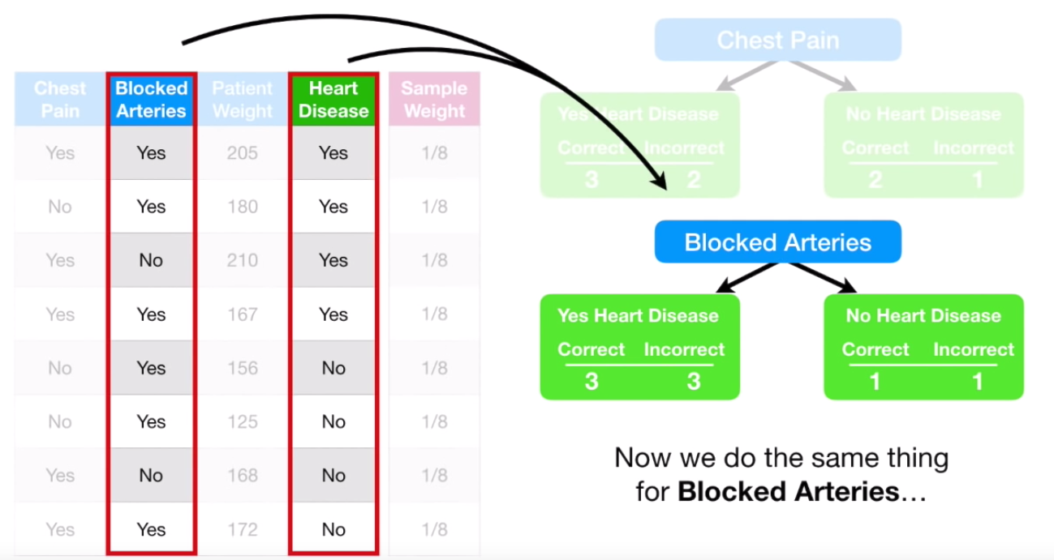
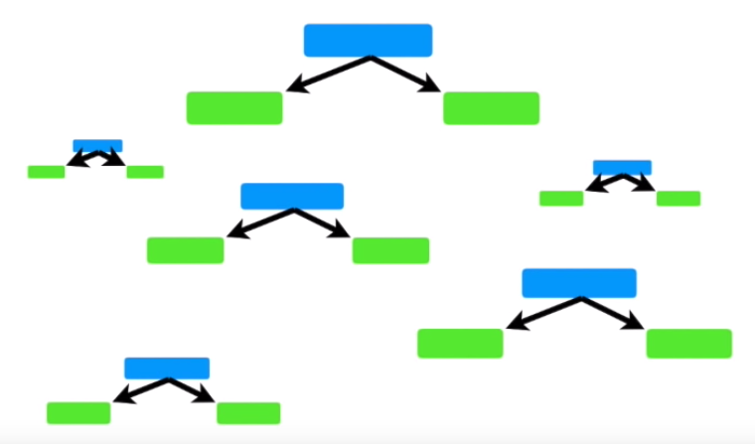
AdaBoost Ensemble Weighted Decision Trees
AdaBoost
Gradient Boosting
XGBoost
Notes:
https://www.youtube.com/watch?v=LsK-xG1cLYA

Slide 30
AdaBoost Ensemble Weighted Decision Trees
bounding boxes with probability

Slide 31
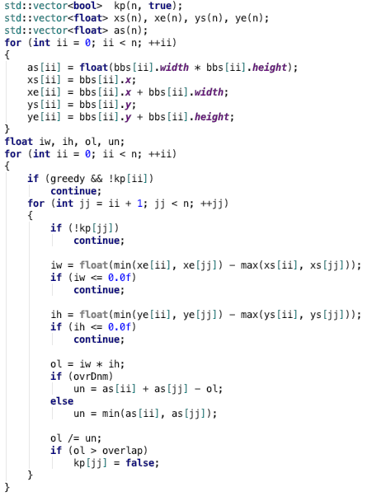
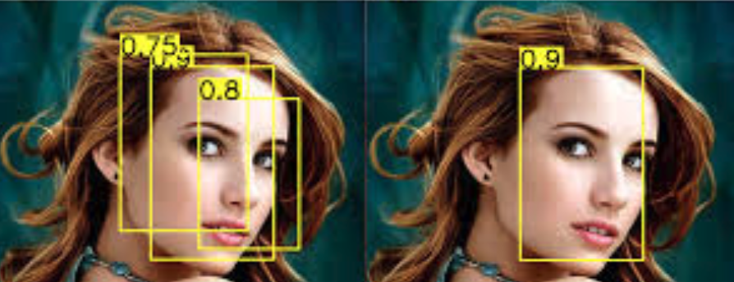
Non-Maximal Suppression
1. overlap?
intersect area / union area > 0.5 ?
2. if overlap, choose best score
nested for loop computations;
begging for GPU

Slide 32
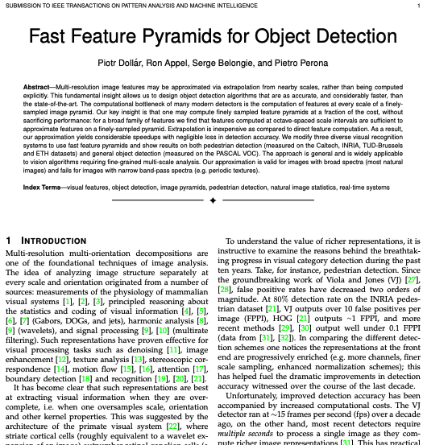
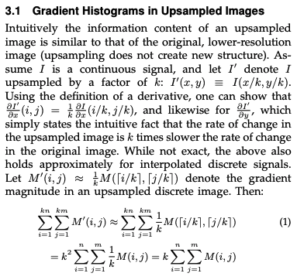
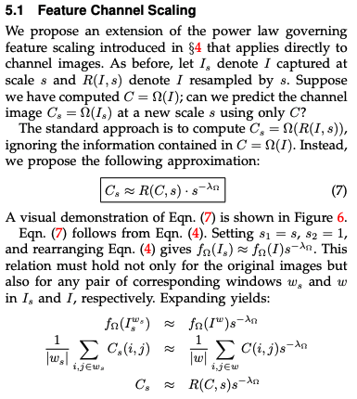
Object Detection w/ Fast Feature Pyramids

Slide 33
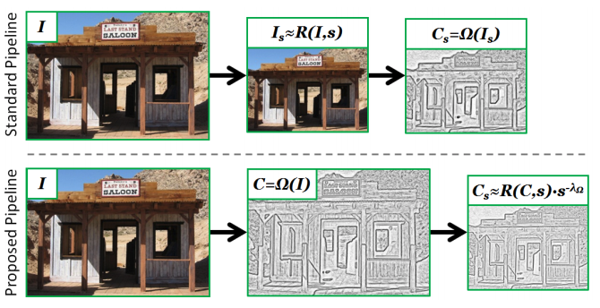
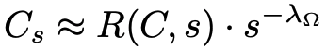
Object Detection w/ Fast Feature Pyramids
“natural images have fractal statistics that we can exploit to reliably predict image structure across scales”

Slide 34
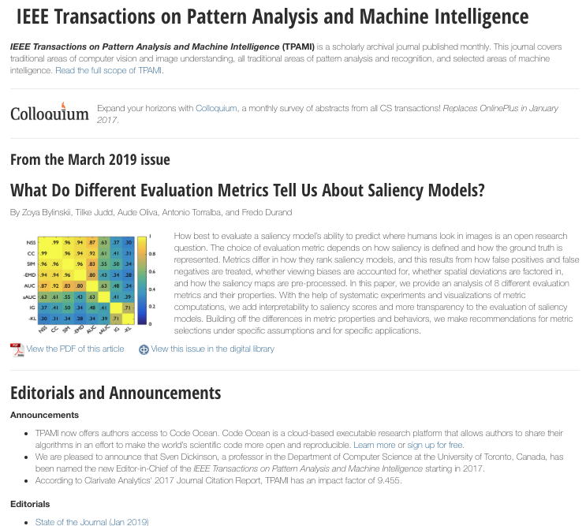
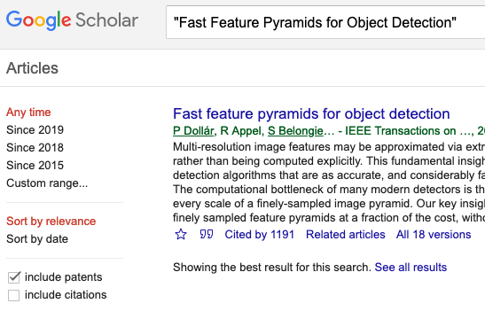
14 dense pages https://eeexplore.ieee.org/xpl
Cited 1191 times!!!

Slide 35
Interactive Algorithm
DEMONSTRATION
William Hill
Lead Data Scientist
william.hill@vion.com
github.com/will-hill

Slide 36
What is next?
Ways to improve

Slide 37
Update Decision Tree Ensemble
AdaBoost
XGBoost

Slide 38
HDecideIT Meta-Algorithm
2. classifying
1. convolving

Slide 39
Swap Classifier to Neural Net

Slide 40
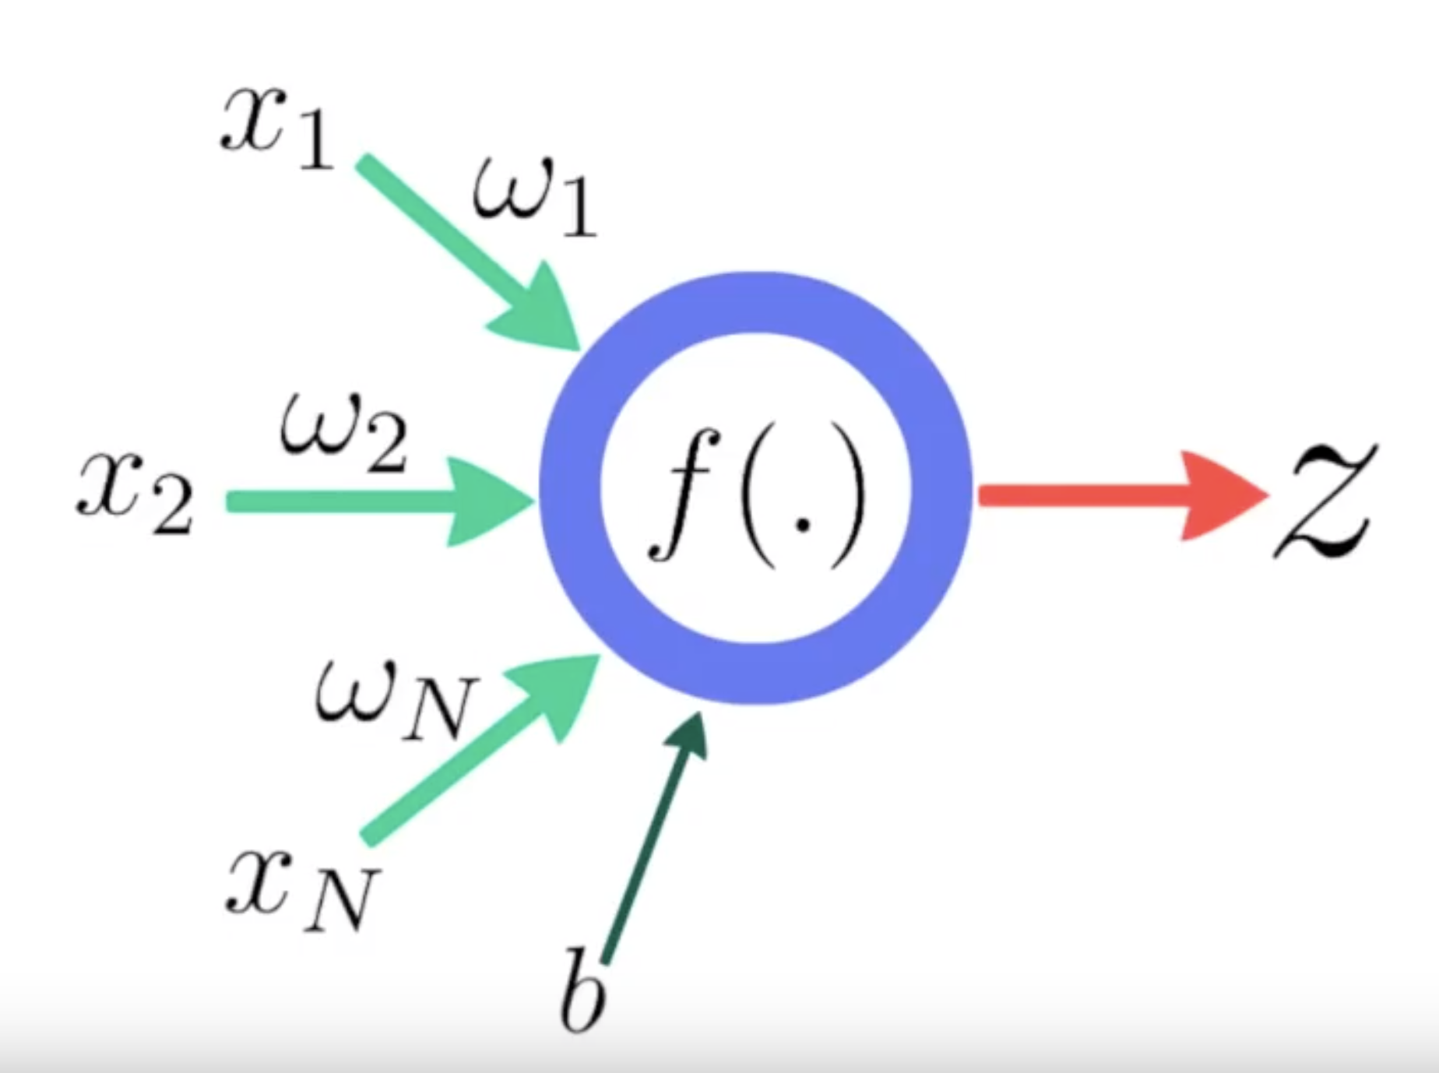
Replace Classifier portion with DNN
DNN Polynomial Transfer

